Slide 1
Decentralized Applications Using Blockchain (DAPP)

Slide 2
Keywords
Ether
Proof Of Work
Smart Contract
Node
Miner
Ethereum
Token
Ledger

Slide 3
Literature Survey
1. Untangling Blockchain: A Data Processing View of Blockchain Systems
DOI : 10.1109/TKDE.2017.2781227
2.EduCTX: A Blockchain-Based Higher Education Credit Platform
DOI : 10.1109/ACCESS.2018/2789929
3. Decentralized Applications: The Blockchain-Empowered Software System
DOI : 10.1109/ACCESS.2018.2870664
Decentralized Big Data Auditing for Smart City Environments Leveraging Blockchain Technology
DOI: 10.1109/ACCESS.2018.2888940

Slide 4
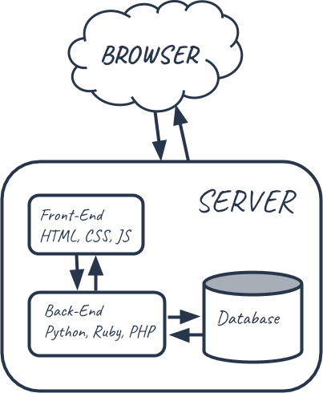
Traditional Web-Structure

Slide 5
Issues in traditional web structure
Bureaucracy
Mistakes in Registration
Lack Of Transparancy
Fraud From Third parties
Cost of Intermediaries
Agreement Issues

Slide 6
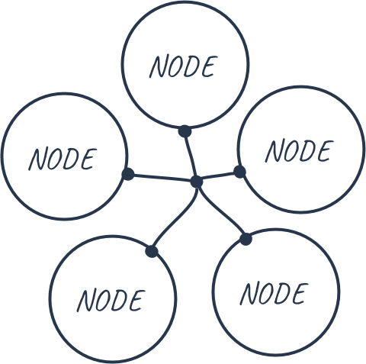
Peer to Peer Network

Slide 7
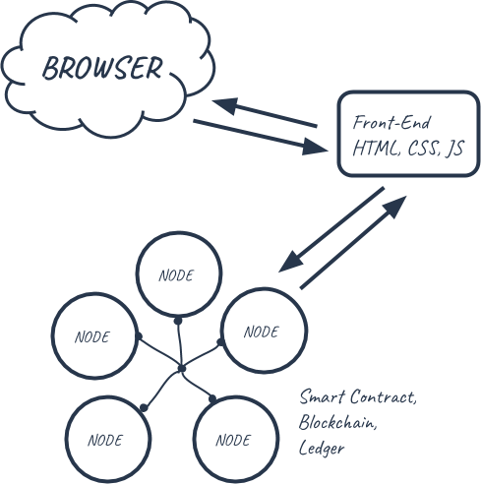
Decentralized Structure
Structure of decentralized application
Standard Points
No centralized server
Using peer to peer network a decentralized structure is achieved
This network is called as the public ledger

Slide 8
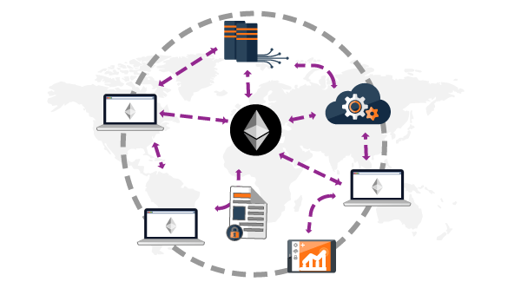
Overview of the Decentralized Environment

Slide 9
Advantages Of Decentralized
Disintermidiation
Lower Transaction Cost
Greater Transparancy
Enhanced Security

Slide 10
Technologies Used
Node Js
Truffle FrameWork
Ganache is our local blockchain
Solidity Programming Language for smart contracts
MetaMask google chrome extension for end user
Web3.js
IPFS system for hosting

Slide 11
Weekly Plan
1st week: Survey of the topic
2nd week: Studying the blockchain domain along with the technologies used
3rd and 4th week: Learn and implement the Solidity programming language
5th and 6th week : Implement a basic blockchain
7th week: Testing

Slide 12
Conclusion
This app will establish transparency and security of the data and its sensitive information
It will bring a sense of trust in the real estate industry without intermedi
This technology has its own advantages with some flaws
In this project we will try to overcome its flaws

Slide 13
References
www.dappuniversity.com
The following article was of great help
https://medium.com/ethereum-developers/the-ultimate-end-to-end-tutorial-to-create-and-deploy-a-fully-descentralized-dapp-in-ethereum-18f0cf6d7e0e

